Slide 1
Electronic Meeting Thought Force Report to the Oregon Area Assembly November 20, 2021

Slide 2
Electronic Meeting Thought Force Committee members
Bonnie W, GR for How Al-Anon Works, District 10
Kory S-R, DR, District 16
Leila P, GR for NW at Noon, District 9
Linda R, GR for Courage to Change, District 4
Meredith D, DR for District 5
Rita S, DR for District 17, Chair
Ad Hoc members: Joanne C, Group Records Coordinator
Katie W, Oregon Area Delegate

Slide 3
Electronic Meeting Thought Force Charge:
Research and guide the process of allowing a Permanently Electronic Meeting into our service structure or not. Where does Oregon want to go with this information?

Slide 4
Permanent electronic meetings
are registered with the World Service Office (WSO) and have never met in person.
They have always been electronic only and will remain permanently electronic.
These meetings have reported to the WSO directly and have had a different service structure.
At the 2021 World Service Conference (WSC), the Delegates voted for the electronic meetings to become Al-Anon Family Groups.
With this vote, the electronic meetings will be able to elect representatives, including a delegate to the WSC.

Slide 5
TEMPORARY ELECTRONIC MEETINGS
Temporary Electronic meetings were initially in-person but became electronic during the Covid pandemic. These groups will need to return to meeting face to face when doing so is reliably safe or update their group record to become a permanent electronic meeting. We do not currently know how long WSO will allow these meetings to remain temporary.

Slide 6
HYBRID MEETINGS
These meetings have both in-person and electronic elements within the same WSO group ID. They are not separate meetings but rather have in person members and electronic members who participate in the same room at the same time and exchange experience, strength and hope in both ways during their meeting. The members who are electronic participate from wherever they are.

Slide 7
Many questions were raised during the Thought Force’s initial conversations:
How would it change our Oregon Area service structure to have permanent electronic meetings in our Area?
How many meetings in Oregon are contemplating being virtual only?
Would a permanent electronic meeting in the Oregon Area have equity in representation?
Would Districts and Oregon Area meetings have to be hybrid?
What would be the parameters for a permanent electronic meeting to be included in the Oregon Area?

Slide 8
We decided to survey Al-Anon Family Groups (AFGs) in Oregon to get a better idea of how members are experiencing and thinking about electronic meetings.
We received 71 responses to the survey, out of 227 total AFGs in the Oregon Area.

Slide 9
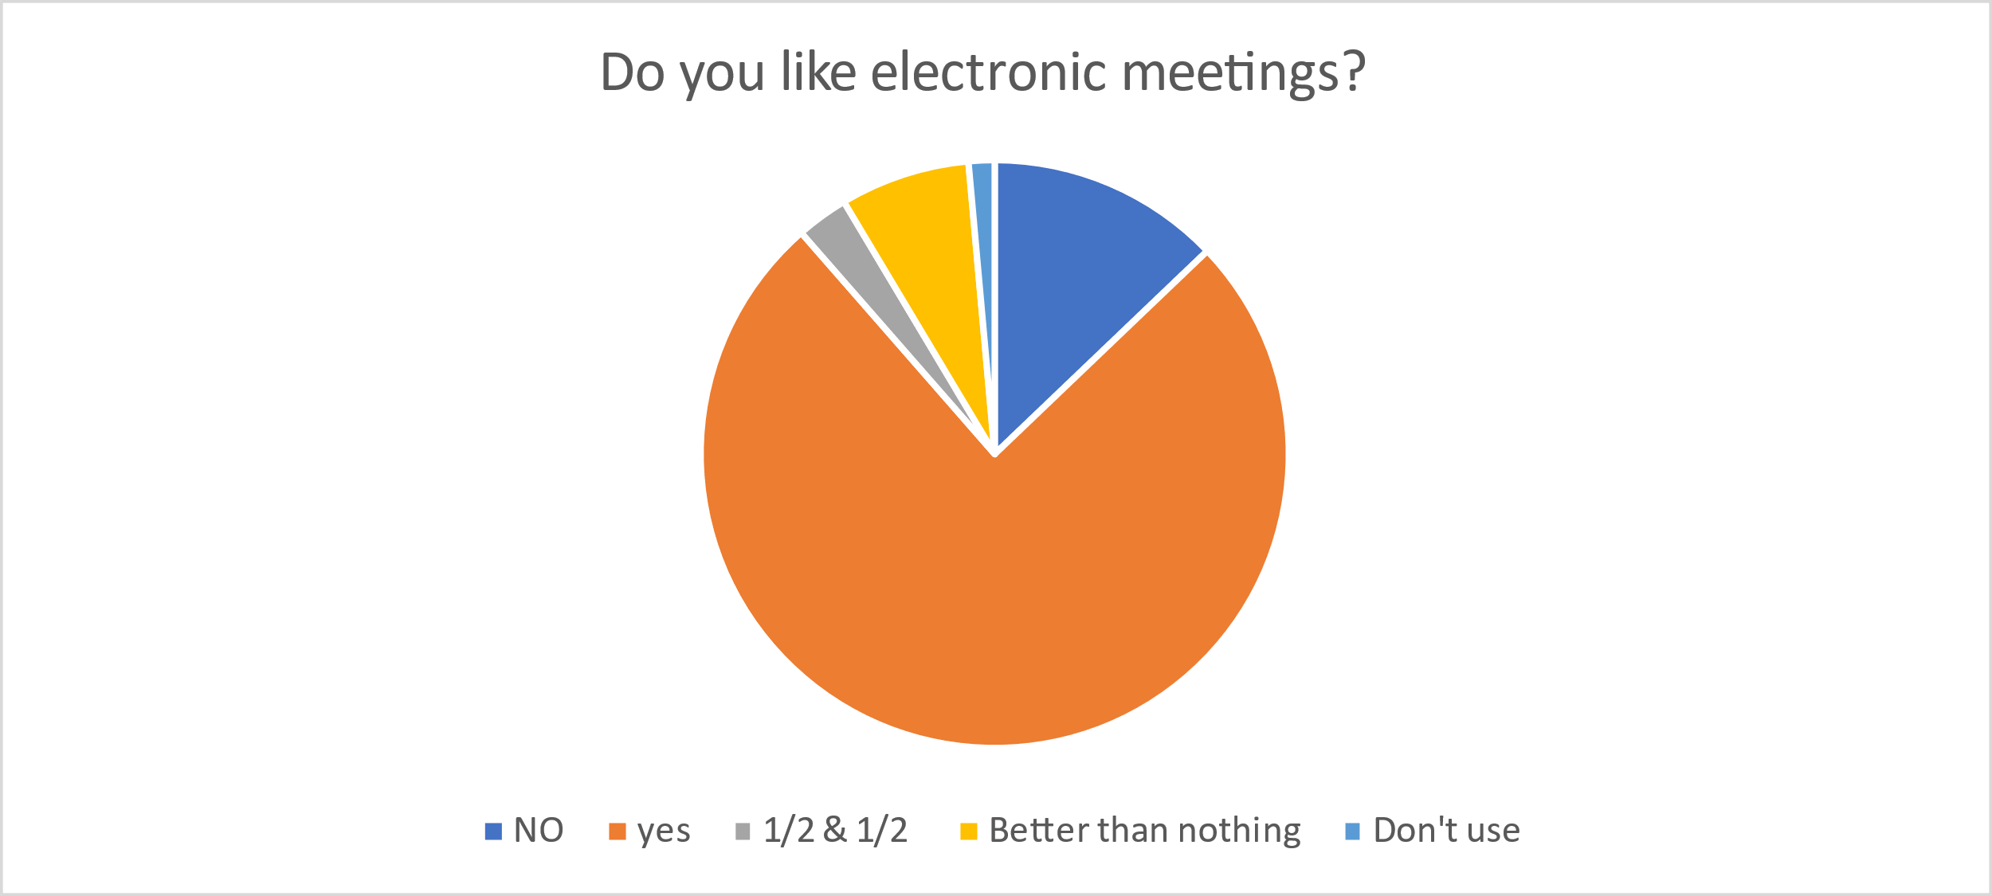
1
2
5
9
53

Slide 10
Why do you like electronic meetings?
Responses | Reasons
59 | Can easily access
53 | No travel time
40 | Variety of times/topics
40 | Diversity of members bringing fresh insights
26 | No need for childcare
10 | Members joining from remote locations
8 | Avoiding Covid exposure
2 | No dress code (Pants and bunny slippers)
1 | can listen from my car

Slide 11
Why do you dislike electronic meetings?
Issues | Responses
Hybrid | 1
Tech Troubles | 10
Perfers face to face | 19
Anonymity | 5
Can’t see everyone | 1
Never been to electronic meeting | 1
Loss of topic focus | 1
Concern for newcomers | 2
Encourages isolation | 1

Slide 12
GRs of Electronic Meetings: Click all that apply to describe your group's current situation.
Current Situation | Responses
Hybrid | 3
Closed | 1
Temporary Electronic | 1
Audio | 1
Face to Face | 2
Temporary electronic thinking of becoming a hybrid | 20
Temporary Electronic thinking of becoming electronic | 3
Temporary Electronic thinking of going to Face to Face | 17
Permanent Electronic | 2

Slide 13
If you are a permanent electronic meeting/group, would you be interested in having a district in Oregon specifically for electronic meetings?

Slide 14
DRs: Which type of electronic meetings do you have in your district?

Slide 15
GRs: Does your group know what format it wishes to have post pandemic?

Slide 16
GRs: If you answered "Yes" above, what format does your group want to have post pandemic?

Slide 17
If you answered "No" or "Unsure" above, what would help your group decide?

Slide 18
GRs of Current Hybrid Meetings: Why has your group decided to become hybrid (check all that may apply to your situation).
Distance members/when out of town can attend 17
Can attend in person 16
Work restrictions 10
Physical access 9
Weather 9
Childcare 7
Membership grew 1
Pandemic concerns 1

Slide 19
GRs: Which statement best reflects your group's hope for the future of your Al-Anon meeting?

Slide 20
KBDM Question # 1 What do we know about our members’ or prospective members’ needs that is relevant to this discussion?
Members need:
Anonymity/safety
Unity
Comfort with online formats
More understanding regarding the differences between temporary electronic meetings, permanent electronic meetings, and hybrid meetings
Equity in representation

Slide 21
KBDM Question 2: What do we know about the resources and our vision for the organization that is relevant to this discussion (finances, membership participation)?
There is a desire among members and their groups to maintain autonomy, and anonymity, in keeping with our Traditions and Concepts.
Members of all types of meetings are in favor of equal representation for all Al-Anon members.
Some members are unsure about their group’s ability to financially support their GR to attend in-person Assemblies

Slide 22
KBDM Question 3: What do we know about the current realities (membership culture), evolving dynamics of the world and our fellowship’s environment (technology, our Legacies and spiritual principles) that is relevant to this discussion? What are the Pros and Cons?
We don’t know how long the pandemic will last
Some members and groups need help with technology
There are divided opinions about the value of, or need for electronic meetings as a part of our Oregon Area service structure

Slide 23
KBDM Question 4: What are the ethical implications of our choices (pros and cons)? In other words, will our decision be consistent with our spiritual principles?
All Al-Anon members will have equal representation at the World Service Conference. Our decision only affects the pathway to representation.
We need to keep in mind Tradition 1, that personal progress for the greatest number depends upon unity.
We need to carefully examine how this decision affects Al-Anon or AA as a whole. (Tradition 4)
Each member benefits in their recovery by participating in service.

Slide 24
KBDM question 5: What do we wish we knew, but don’t?
We don’t know how long the pandemic will last or how long we may need to meet electronically.
We don’t know how many meetings in Oregon do not want to meet face to face.
We don’t know what it is going to cost to get back into in person meetings. (All of these places have been closed (venues, churches)), and some of them are charging groups more money in order to make up what they lost and/or it’s costing more for sanitation, etc.
We don’t know for sure how this decision at the WSO will evolve over the coming year(s)
We don’t know how it would work to incorporate members into our service structure who embody different cultures and languages and live in different countries and time zones.

Slide 25
What is best for the Oregon Area? What is best for the membership?
In the survey, we were trying to find out what members say they want and need. Many members don’t know the answers to these questions yet. There is confusion regarding the differences between permanent electronic meetings, temporary electronic meetings, and hybrid meetings.
An individual group may not be concerned that its members represent different states and countries as it makes decisions for itself. But once a Group’s decisions impact the District they’re in, and the Oregon Area as a whole, we must consider what is best for each.
Does the Oregon Area have the capability to support permanent electronic meetings technologically?
Does the Oregon Area want members from outside of Oregon influence Oregon Area decisions?
We need to examine this from every angle to see what benefits the greatest number and provides unity for Oregon.

Slide 26
Electronic Meeting Thought Force Recommendations
1. We recommend that permanent electronic meetings do not become part of the Oregon Service Structure at this time.
2. We recommend that the Oregon Area continue to offer education on the differences between temporary, permanent and hybrid electronic meetings, and how the Area sees that the Service Structure will be affected by the changes.
3. We think making this decision during COVID is a mistake. We recommend that another survey be conducted when most meetings have returned to face to face to see how the Oregon Al-Anon membership thinks and feels about electronic meetings at that time.

